Slide 1

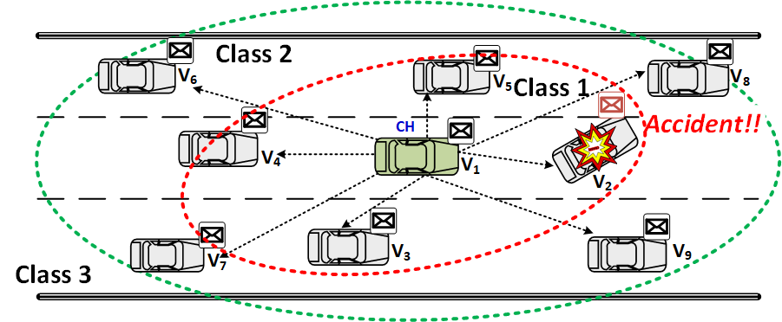
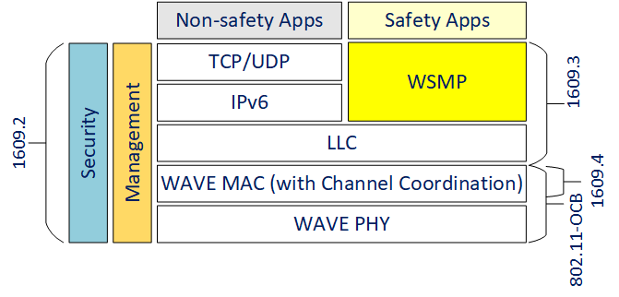
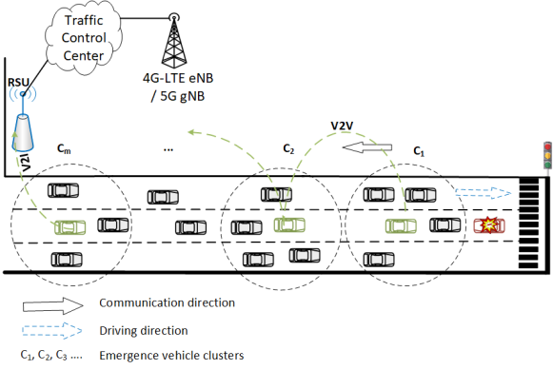
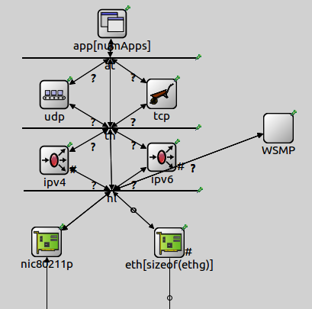

IP Wireless Access in Vehicular Environments (IPWAVE) Basic Protocols
Champion: Jaehoon Paul Jeong (SKKU)
IETF-108 Hackathon
Context-Aware Navigator
Protocol (CNP) over IPWAVE
Context-Aware Navigator Protocol
Objectives:
Demonstrate IPWAVE Basic Protocols
Discover technology gaps for IPWAVE
Where to get source code:
Git-hub open source:
https://github.com/ipwave-hackathon-ietf
How to set up an environment:
OS: Ubuntu 16.04
OMNeT++: 5.4.1
SUMO: 0.32.0
Veins: 4.7.1
INET Framework: 4.0.0
Implementation Contents:
Proof of Concept (POC) of IPv6-Based Context-Aware Navigator Protocol
IPv6 mobility information sharing for safe driving in roadways
Coordinated path planning for obstacle and collision avoidance in roadways
Efficient driving information exchange in IP-based vehicular networks
Network-based coordinated driving environment sensing and perception
Vehicular Simulations of IPWAVE with OMNeT++, SUMO, and VEINS
Professor:
Jaehoon Paul Jeong (SKKU)
Younghan Kim (SSU)
Students:
Bien Aime Mugabarigira (SKKU)
Yiwen Chris Shen (SKKU)
Ahn Yoseop (SKKU)
Kyoungjae Sun (SSU)
WAVE Protocol Stack
Vehicular Network Architecture
Vehicle Structure in OMNeT++

